Slide 1
PROBLEM STATEMENT
In this project, I play the role of fleet manager for ANT, a freight trucking corporation.
Accidents caused by large trucks are devastating, causing severe property damage and potentially loss of life. Moreover, from a business perspective, accidents cause significant revenue loss.
The project objective is to identify risk factors that lead to major trucking accidents in order to mitigate them as much as possible.
Also considered is how profitable the trucks are, based on the different truck models.

Slide 2
Project Technical Details
The next slide will show a visual overview of the technical steps taken for this project.
This project required importing trucking-related csv files from our local system into Vmware, which housed the Hadoop ecosystem tools used.
Within Hadoop, HDFS, Hive, and Impala were used to transform the project data and export to Tableau.
Within Tableau, visual charts and graphs were created to summarize the results.

Slide 3









Project Visual Overview
Moving the files from local system to Vmware
Moving the files from Vmware to HDFS
Creating the tables and inserting the data in the Hive server
Creating the visualizations and retrieving the insights
Importing the tables to the Tableau using the Impala ODBC driver

Slide 4


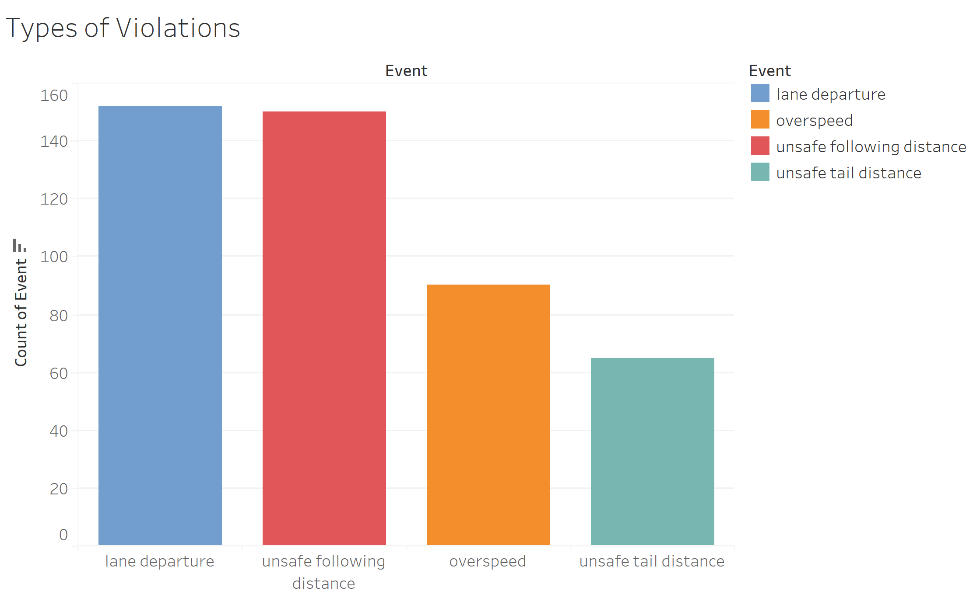




Slide 5


Slide 6
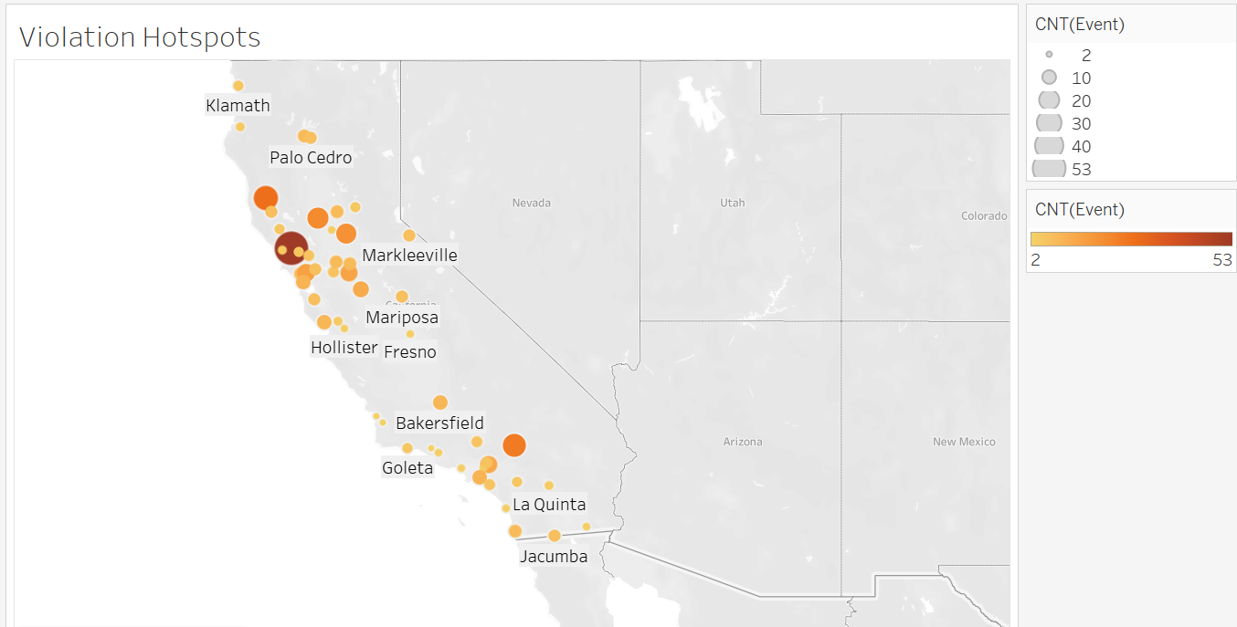
LOCATIONS WITH HIGHEST NUMBER OF VIOLATIONS

Slide 7
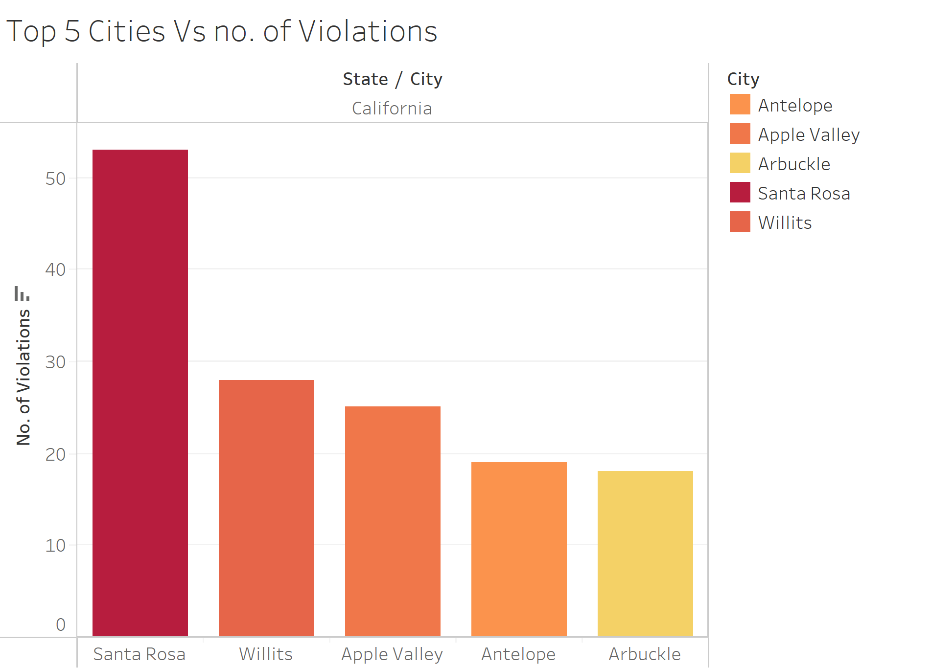
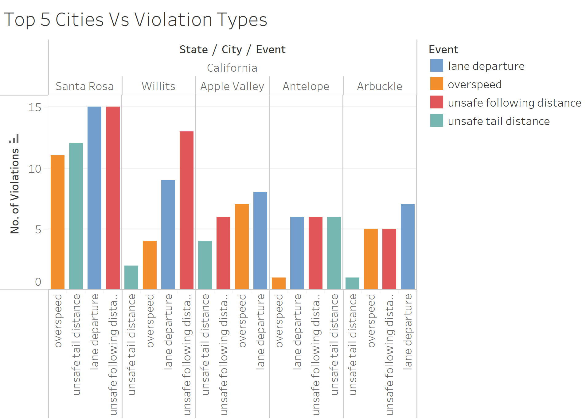

Slide 8
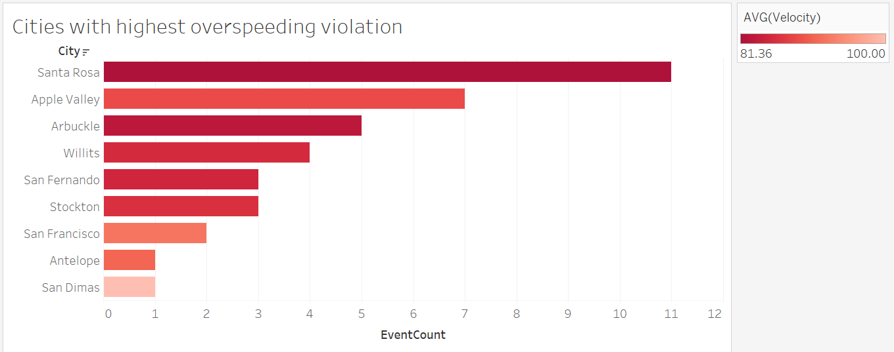

Slide 9
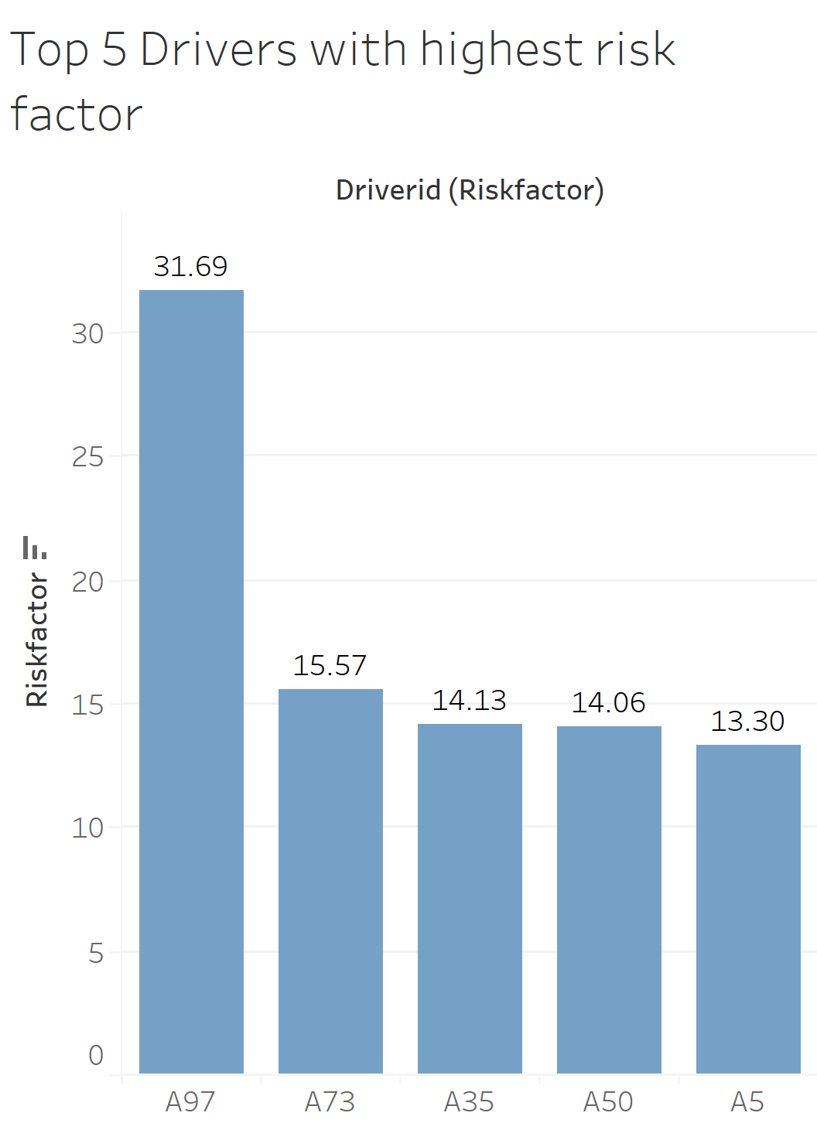
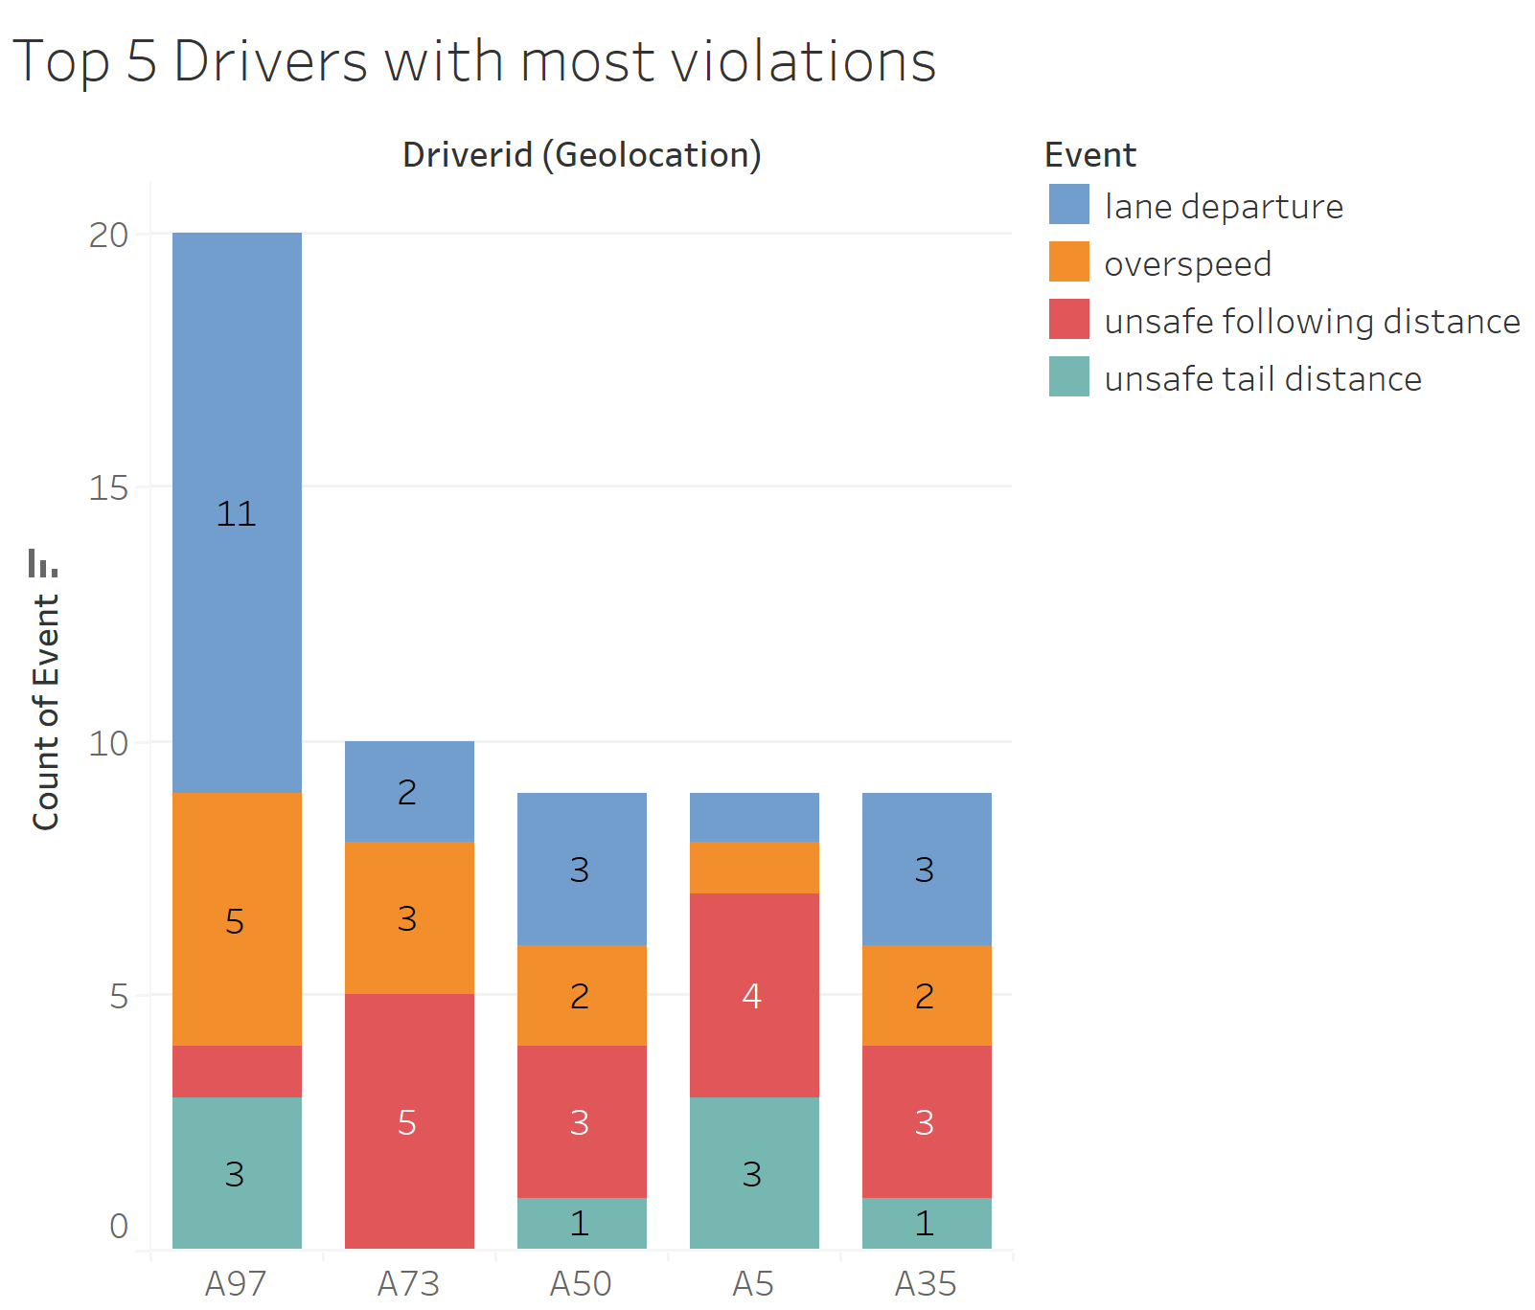

Slide 10
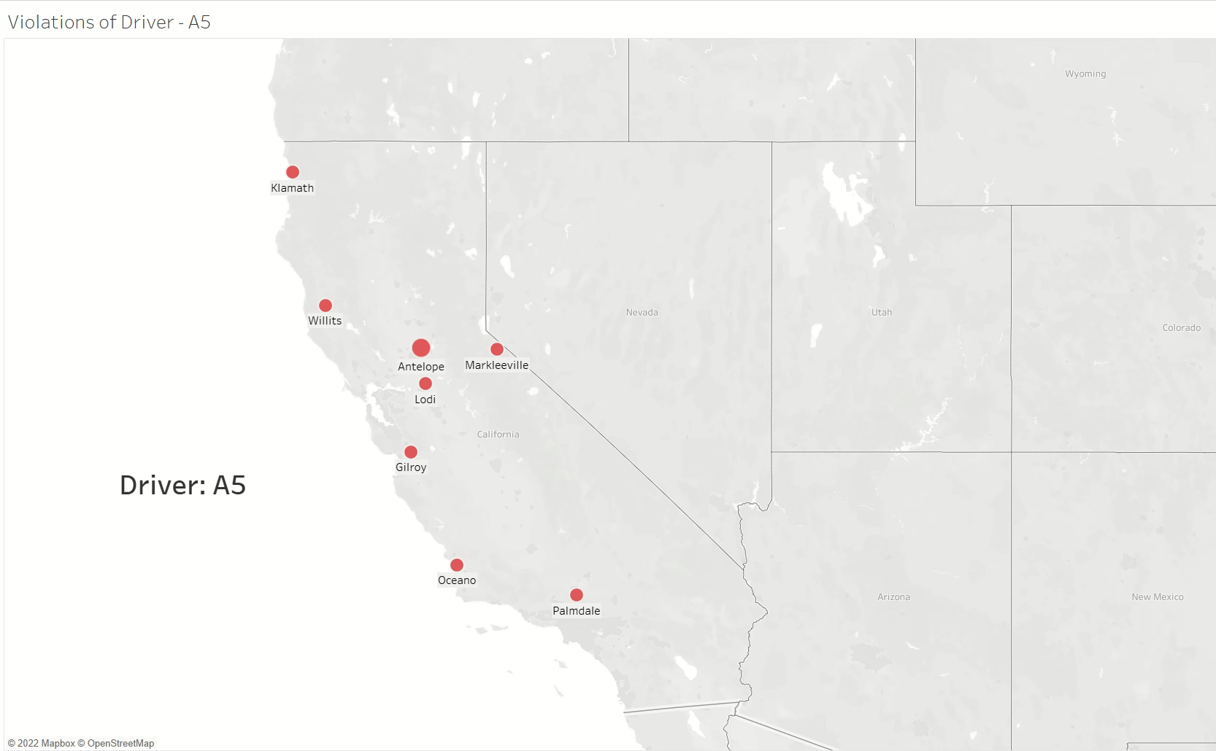
Top 5 Driver violations with respect to cities

Slide 11
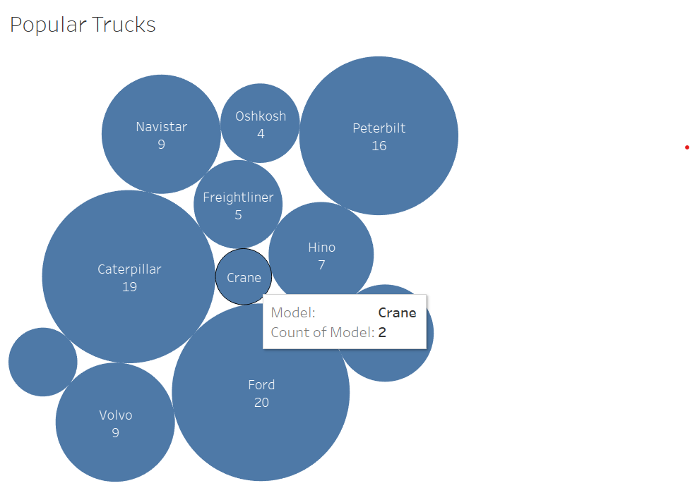
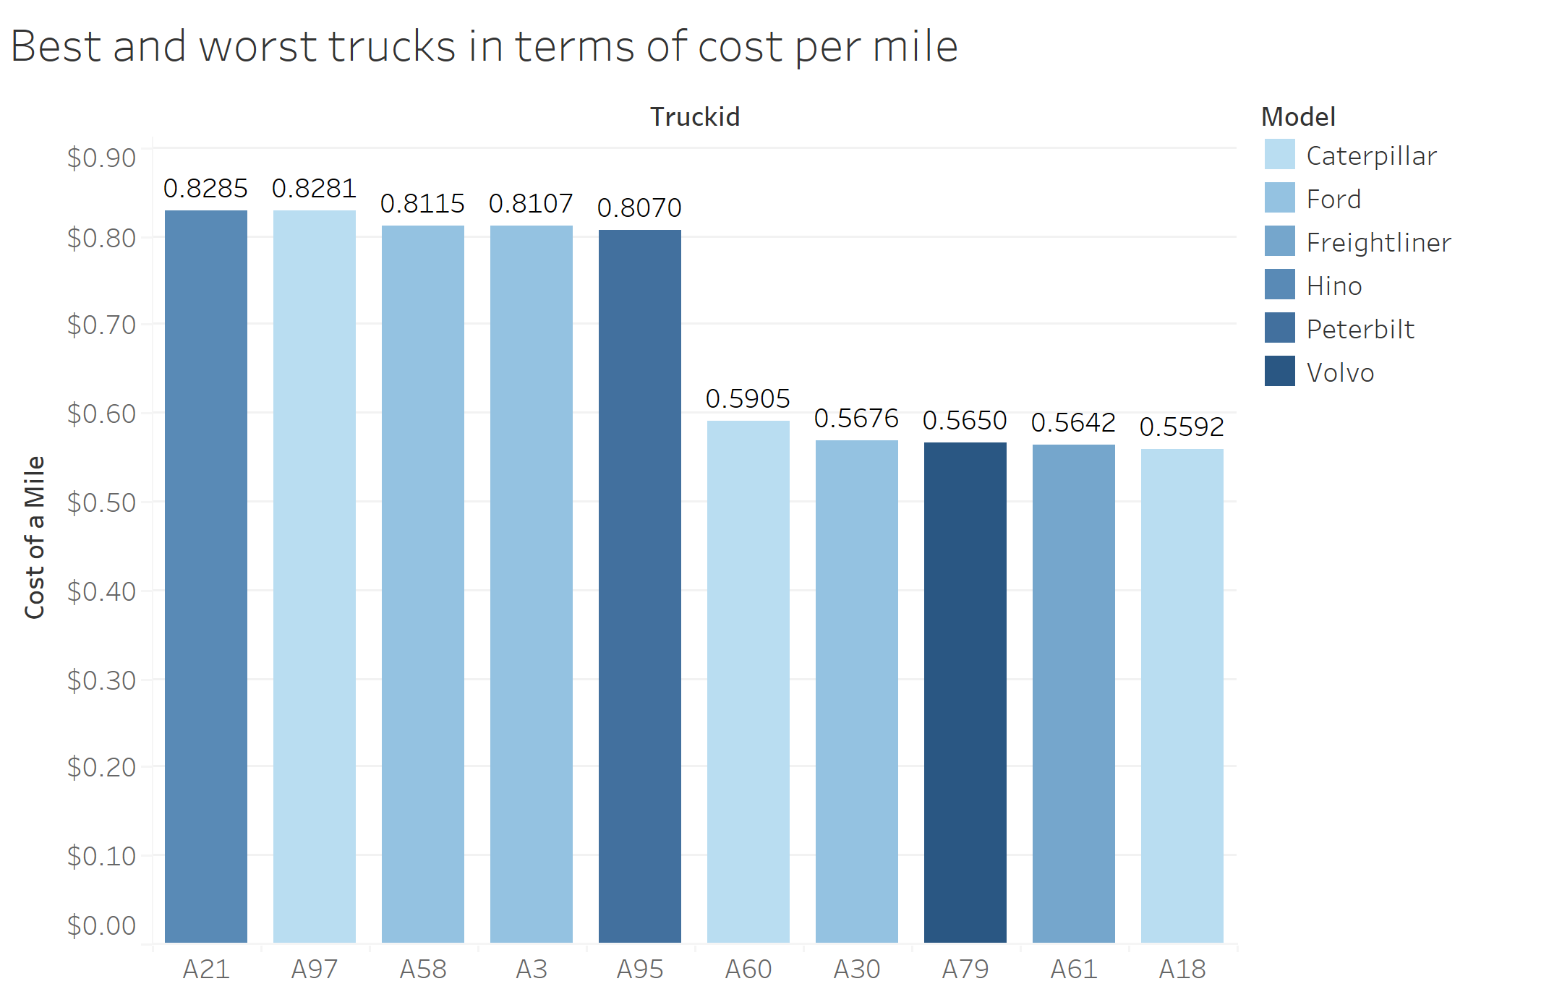
Other observations:
This visual shows the number of drivers with respect to the truck models
It helps to understand which truck models are used by highest number of drivers.
Cost of gas per mile with respect to truck ids
The gas prices for the period between January 2009 and June 2013 were used to calculate the cost of gas per mile.
This was done to understand the difference in cost of gas per mile with respect to the model

Slide 12
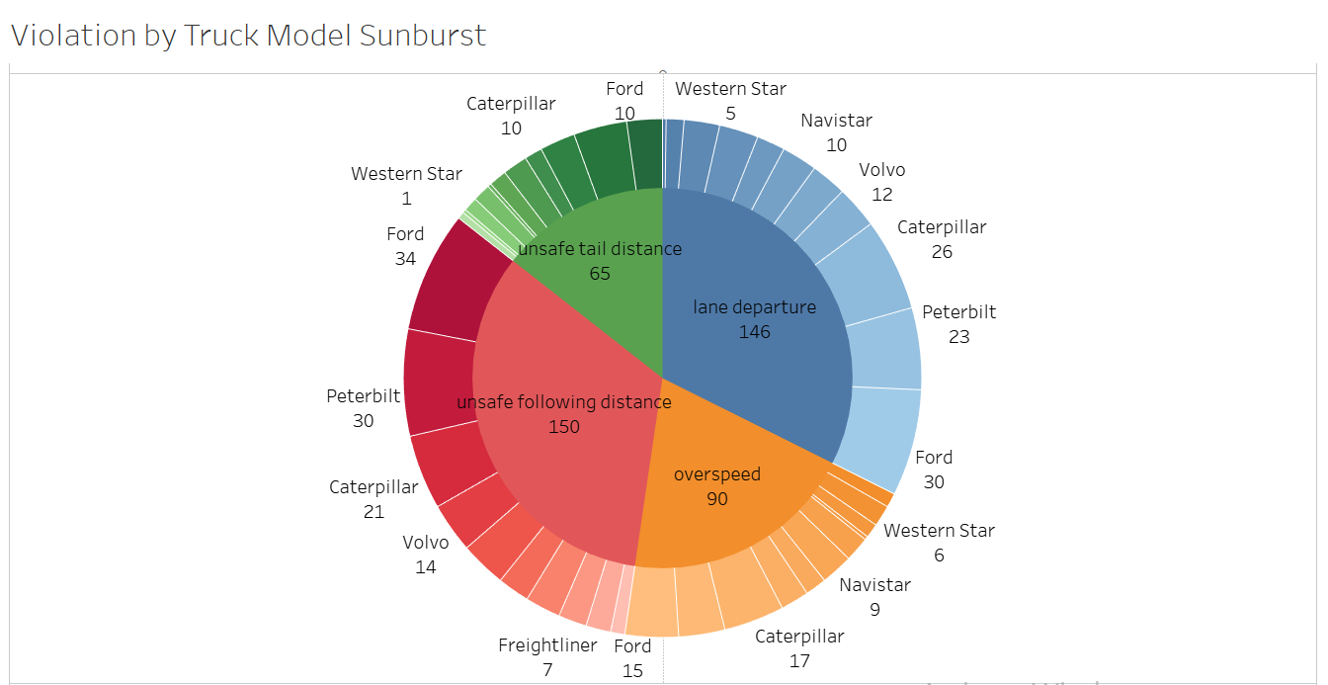
Performance of truck models based on various truck violations

Slide 13
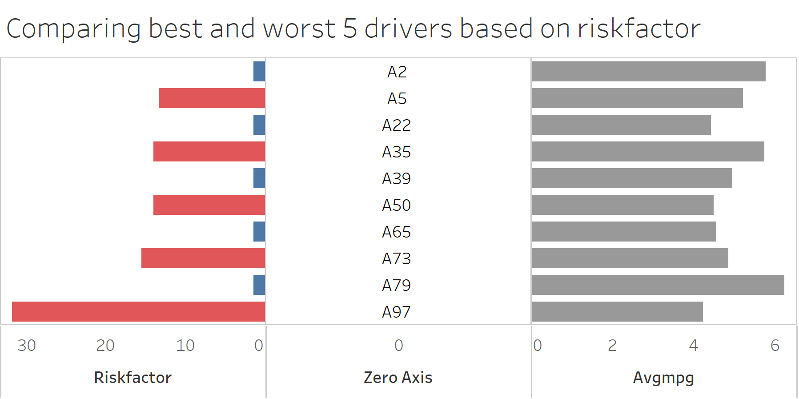

Slide 14
Insights to Mitigate Truck Accidents
Drivers with risk factors near the threshold risk factor of 7 should be issued warnings, while drivers with low risk factors (<4) should be rewarded on monthly basis to incentivize good driving
Drivers at or exceeding the threshold risk factor of 7 should be considered for termination to minimize trucking accidents
To minimize gas expenditures, it is recommended to use trucks with higher fuel efficiency.
It was found that Crane(2) and Volvo(9) models are the most fuel-efficient models and yet their count was found low. So, it is suggested to increase drivers with these more efficient truck models

